Slide 1
How we migrated our Monolith to K8s and became a high performing team
Tracy Miranda, Mauricio Salatino

Slide 2


About Us
Tracy Miranda @CloudBees
@tracymiranda
Board Chair @CD.Foundation
Mauricio Salatino
@salaboy
@Camunda / @LearnK8s

Slide 3

Agenda
How to make it happen:
Principles
Examples
Challenges

Slide 4
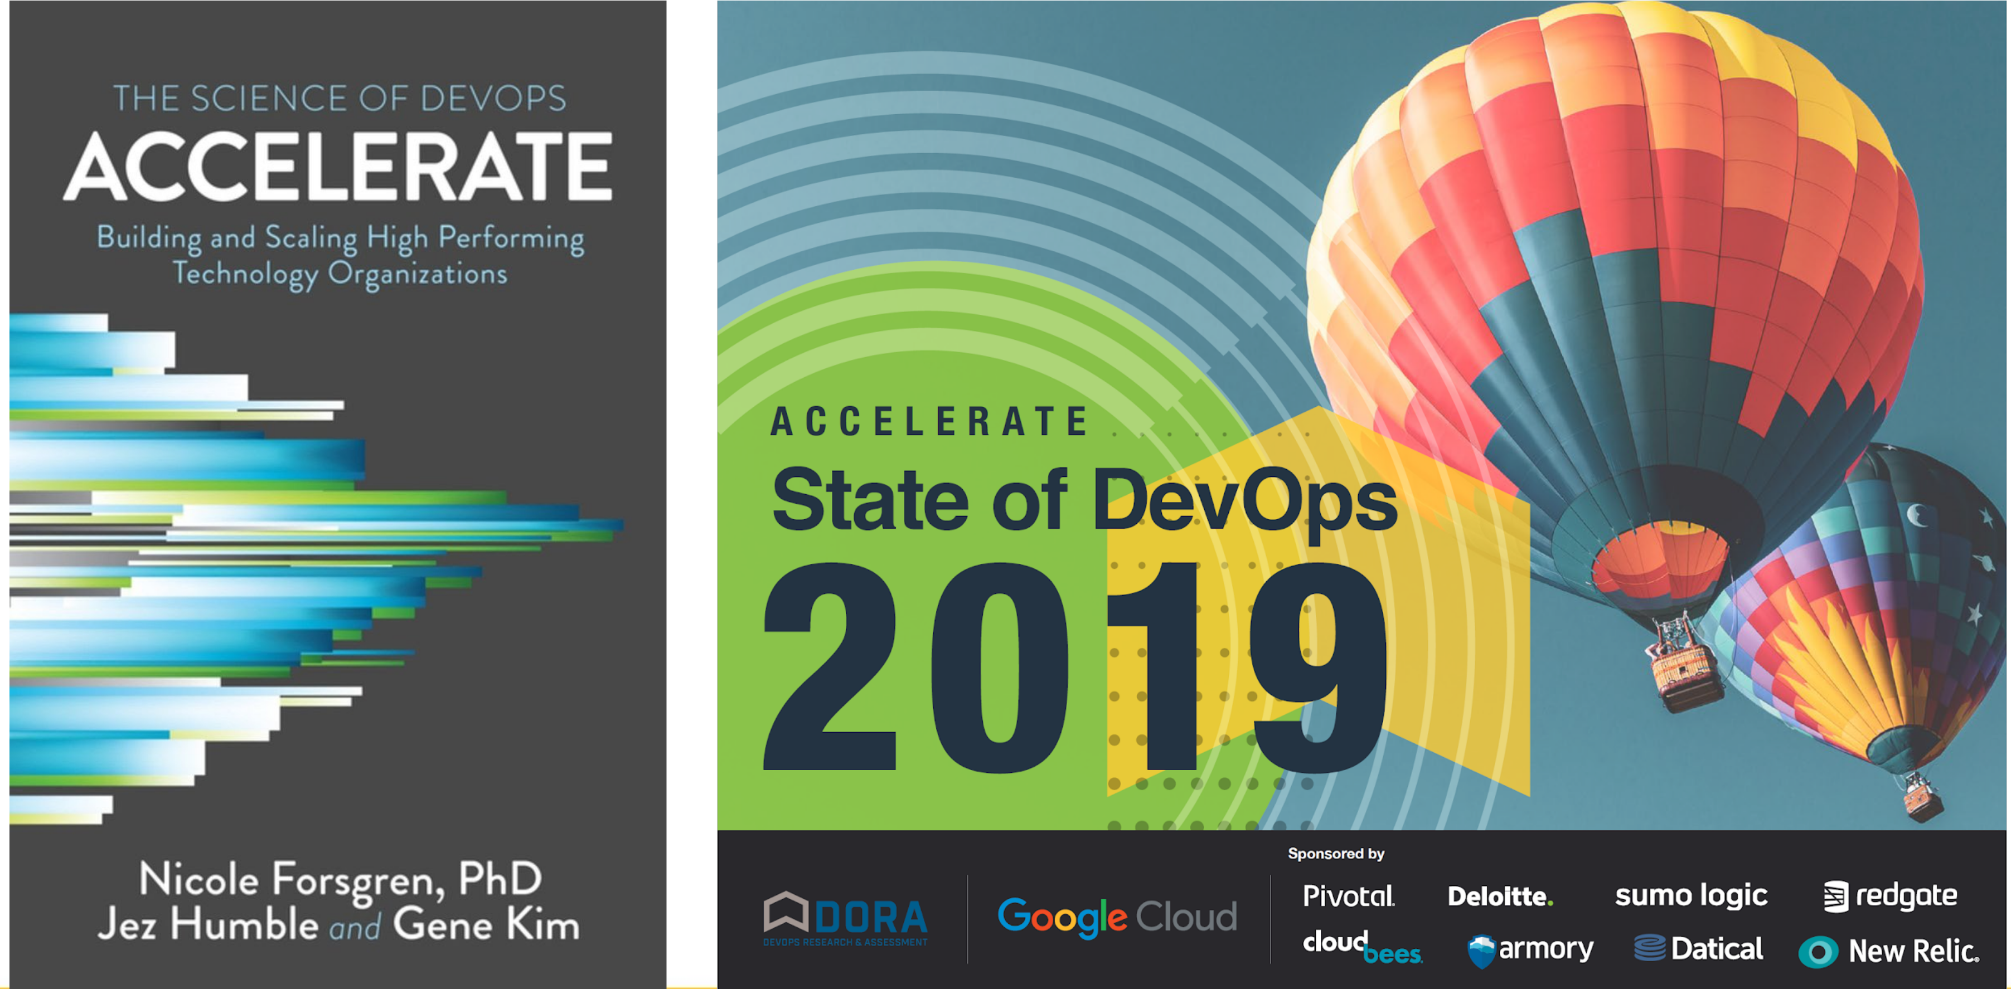
Accelerate

Slide 5
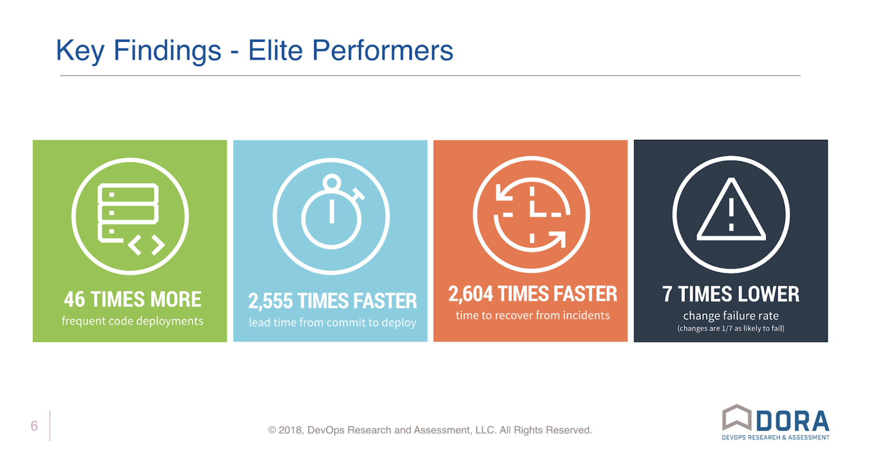
Key Findings - Elite Performers

Slide 6
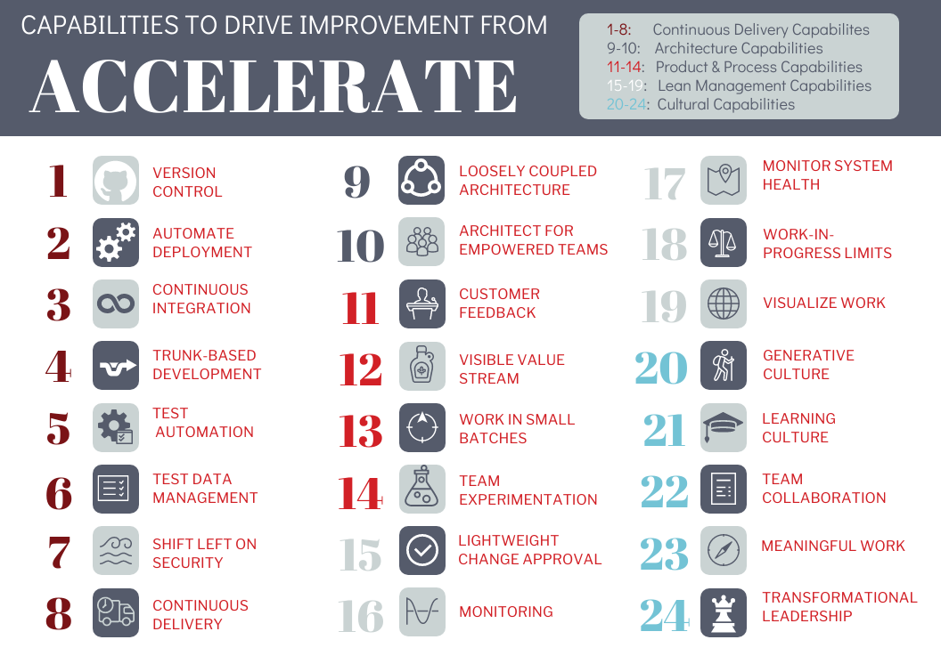
Accelerate

Slide 7
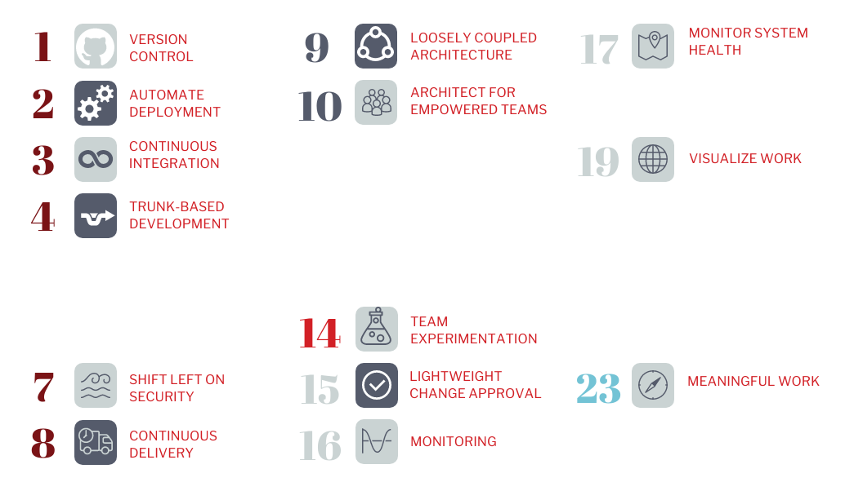
Where tools can help?

Slide 8

Jenkins X

Slide 9
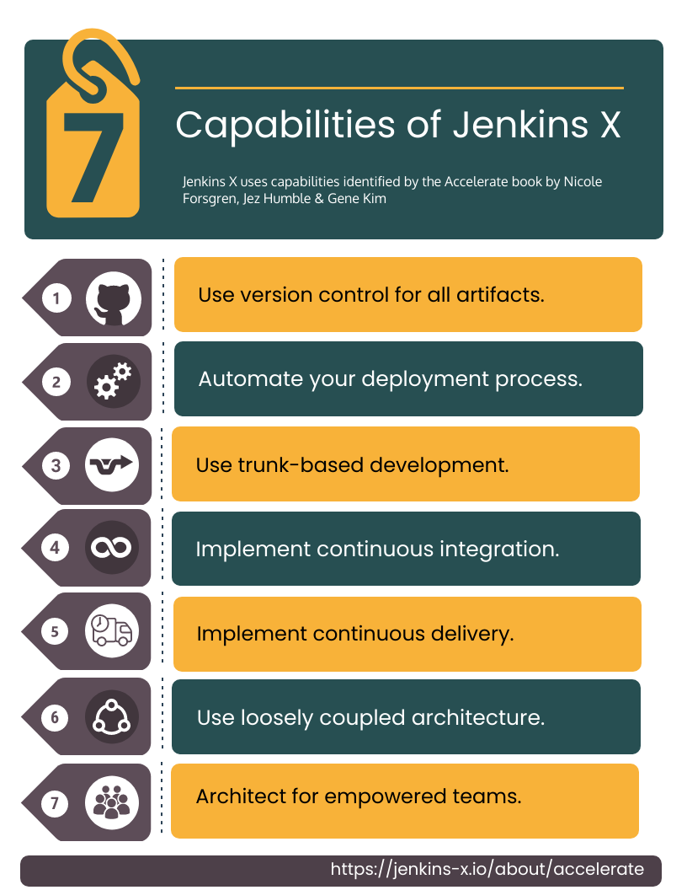
Jenkins X

Slide 10

Jenkins X: CI pipeline

Slide 11
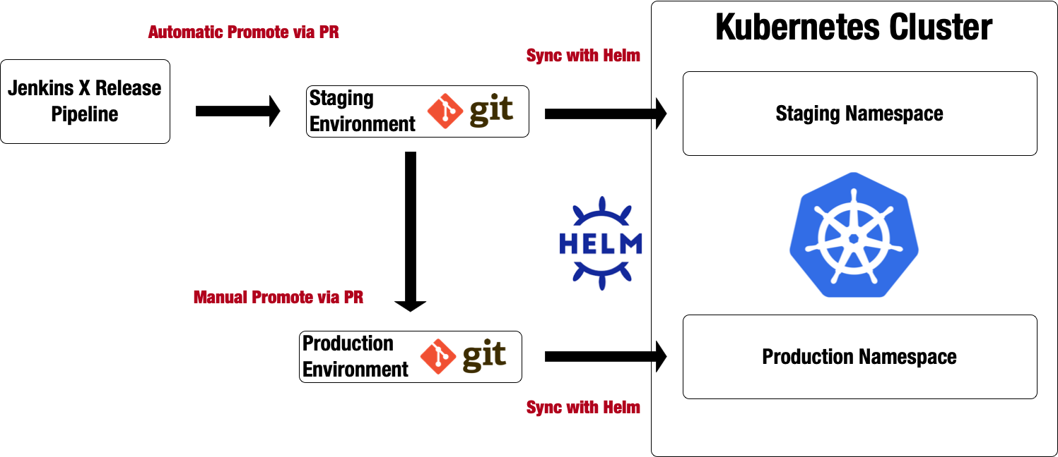
Jenkins X: CD and GitOps

Slide 12
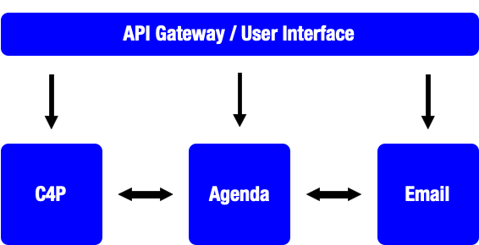
From Monolith to K8s
http://github.com/salaboy/from-monolith-to-k8s
Conference Site

Slide 13
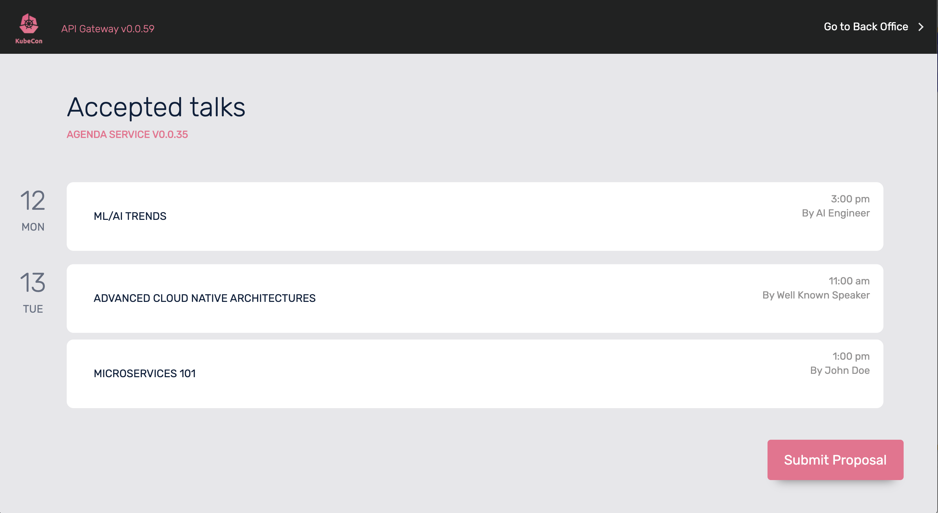
Demo #1
http://fmtok8s-api-gateway-jx-staging.34.65.78.40.nip.io/

Slide 14
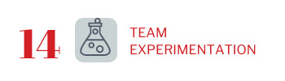

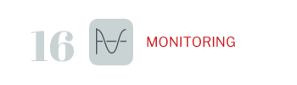
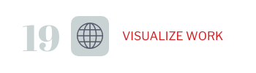
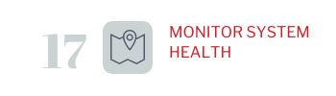
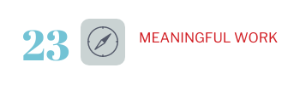
Back to Accelerate

Slide 15

Challenges
Technical
Applications as a Set of Services
App Infrastructure: Hosted or Managed?
Business Visibility

Slide 16
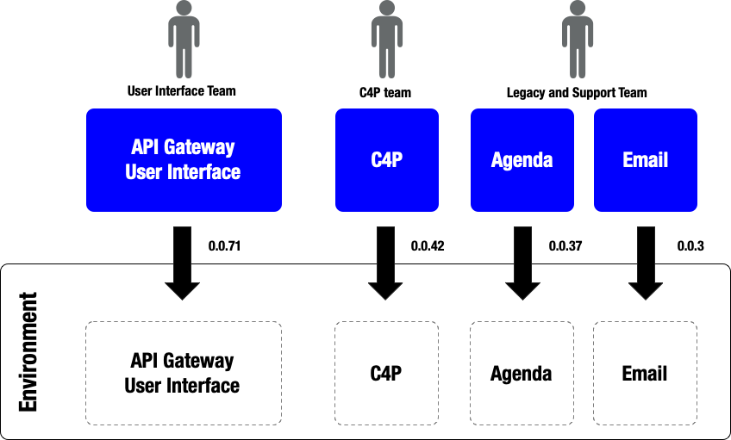
There is no Application

Slide 17
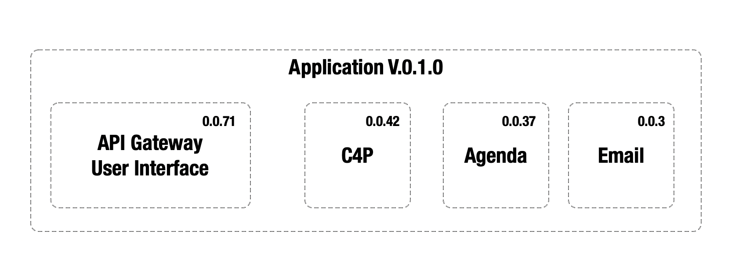

Helm to the Rescue!
https://github.com/salaboy/fmtok8s-api-gateway/blob/master/jenkins-x.yml
https://github.com/salaboy/fmtok8s-kubecon-app/blob/master/kubecon-app/requirements.yaml

Slide 18
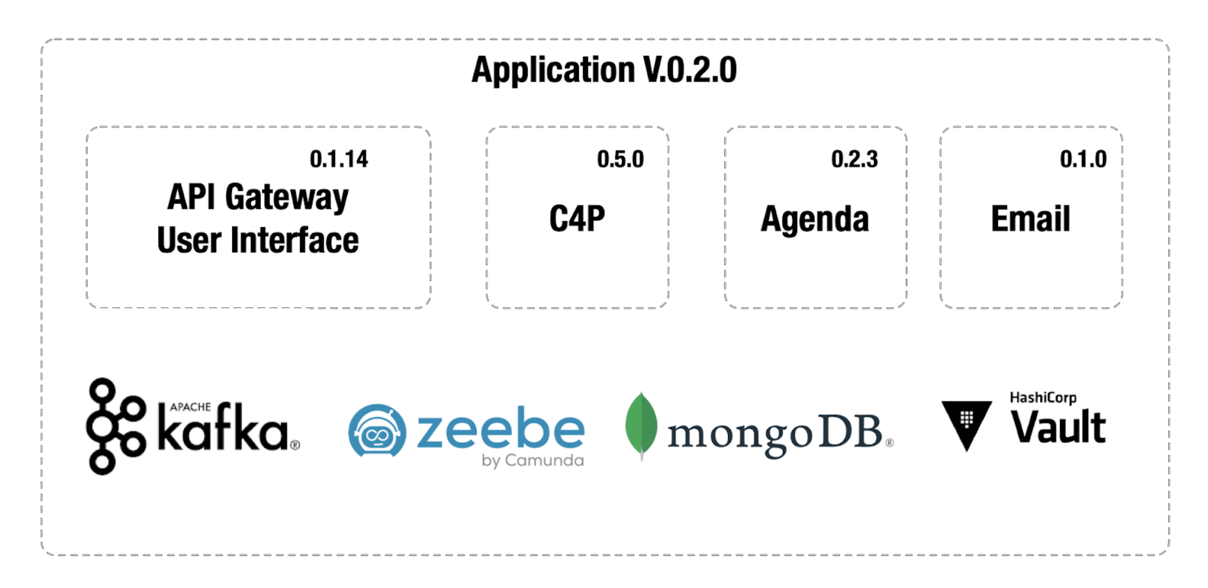
Adding Application Infrastructure
Hosted or Managed?

Slide 19
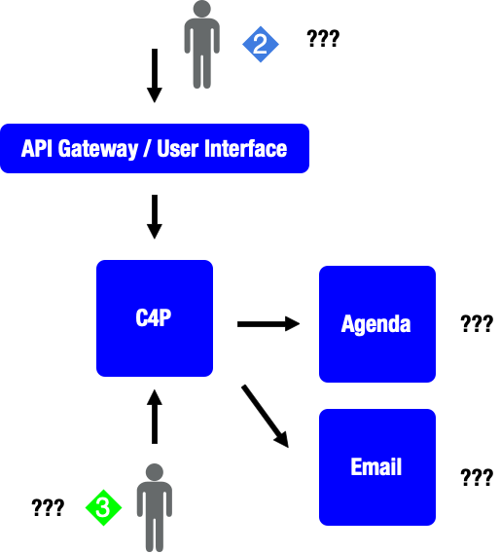
Understanding Process State

Slide 20
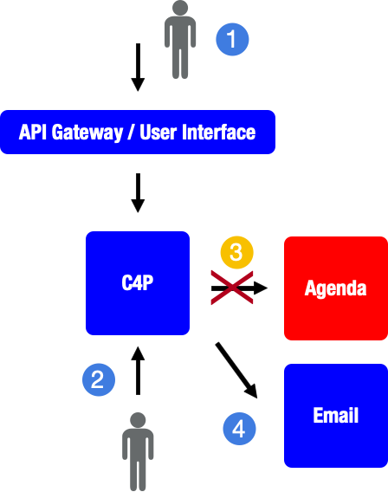
Avoiding Inconsistent States

Slide 21
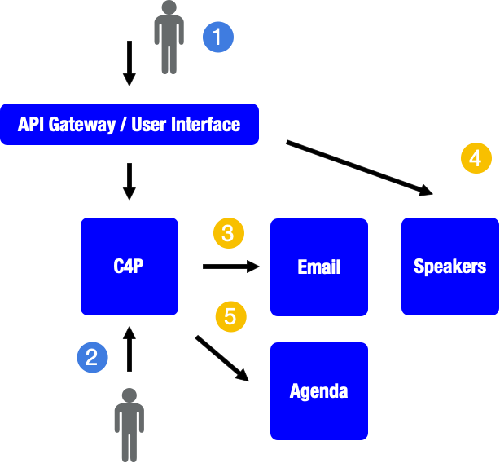
Updating your flow

Slide 22
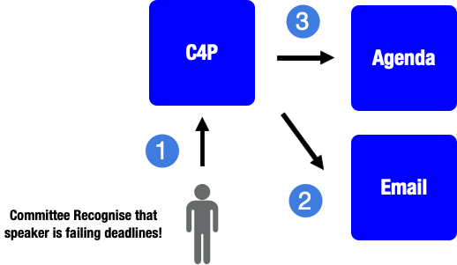
Dealing with Edge Cases

Slide 23
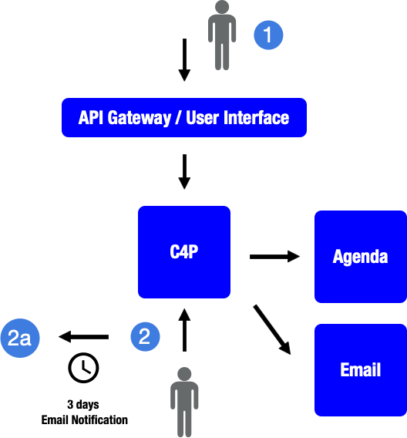
Time sensitive actions

Slide 24

Workflow Engine: Zeebe

Slide 25
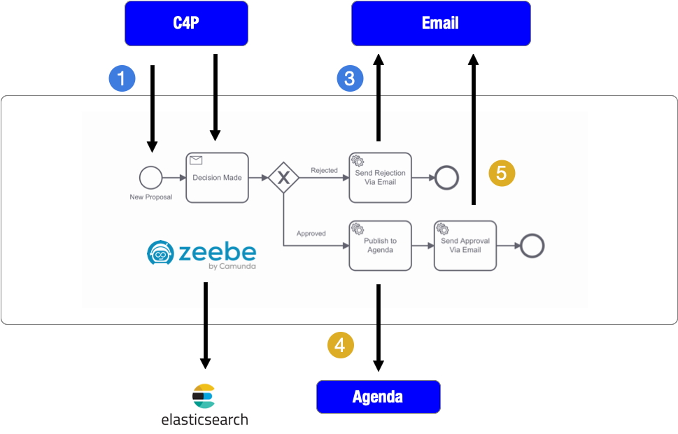
With a Workflow Engine

Slide 26
Takeaways
Jenkins X for CI/CD in Kubernetes
Streamline the answer to Hosted vs Managed
Invest in Business Visibility

Slide 27
Accelerate

Slide 28
Transformational Leadership
VISION
INSPIRATIONAL COMMUNICATION
INTELLECTUAL STIMULATION
SUPPORTIVE LEADERSHIP
PERSONAL RECOGNITION

